Slide 1
Original EPIC Potsdam cohort
(n=27,548)
CRC cases in the subcohort
(n=40)
Random subcohort
(n=2295)
Cases
(n=251)
Supplementary Figure 1. Pictorial representation of the case-cohort study design: the EPIC Potsdam Case-Cohort Study

Slide 2
Supplementary Figure 2: Multivariable-adjusted Relative Risks (95% Confidence Intervals) of Circulating Omentin Concentrations with Risk of Colorectal Cancer with Additional Adjustment for Metabolic Biomarkers: The EPIC Potsdam Case-Cohort Study

Slide 3
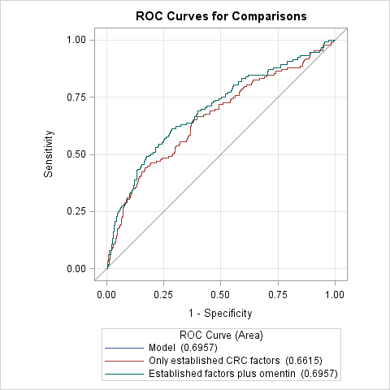
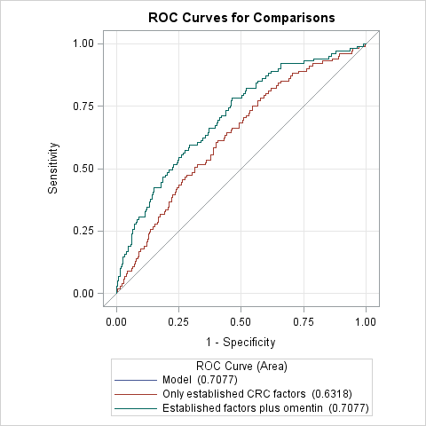
(A)
(B)
P _{for difference between models} <0.0001
P _{for difference between models} <0.0001
Supplementary Figure 3. Predictive ability of pre-diagnostic omentin concentrations beyond established lifestyle and metabolic risk factors for colorectal cancer (Panel A) men and (Panel B) women: The EPIC Potsdam Case-Cohort Study

