Slide 1
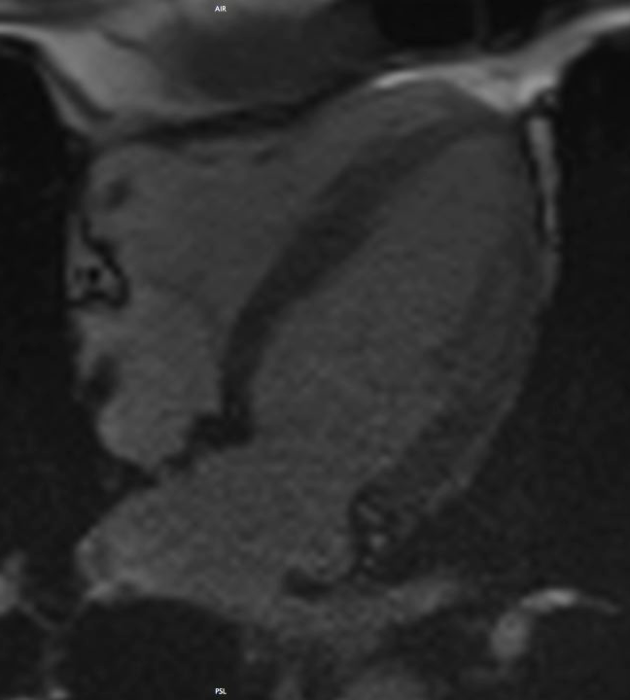
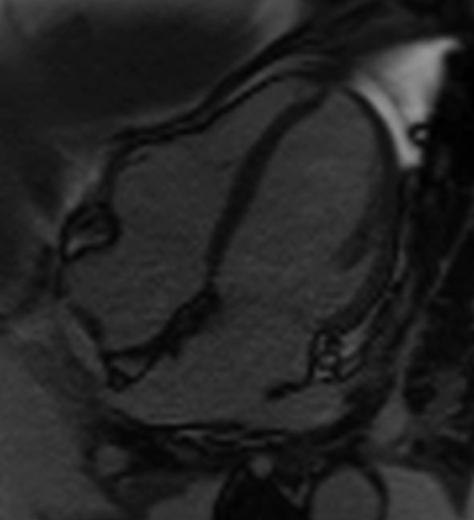
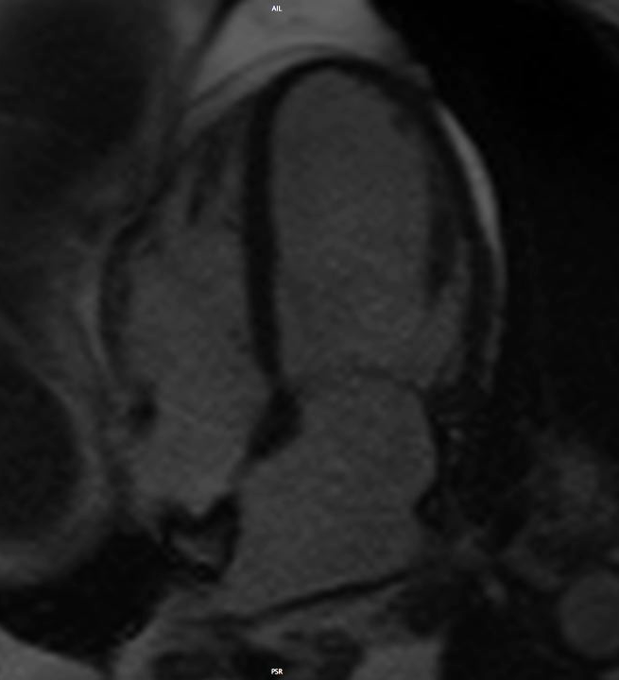
Preserved LVEF
Impaired LVEF
with global hypokinesia
Impaired LVEF
with Tako-Tsubo pattern

